Slide 1

Service Dog Rules by
@Kai.the.Rotten.Rottie

Slide 2
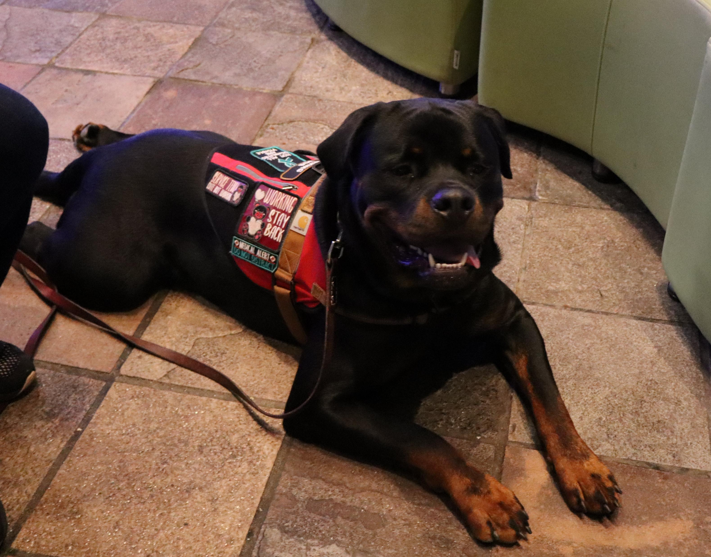
Service Dog
Hi, I’m Kai, a service dog, and I want to help you understand the rules about service animals like me!
We’re here to help people with disabilities live their lives more easily

Slide 3
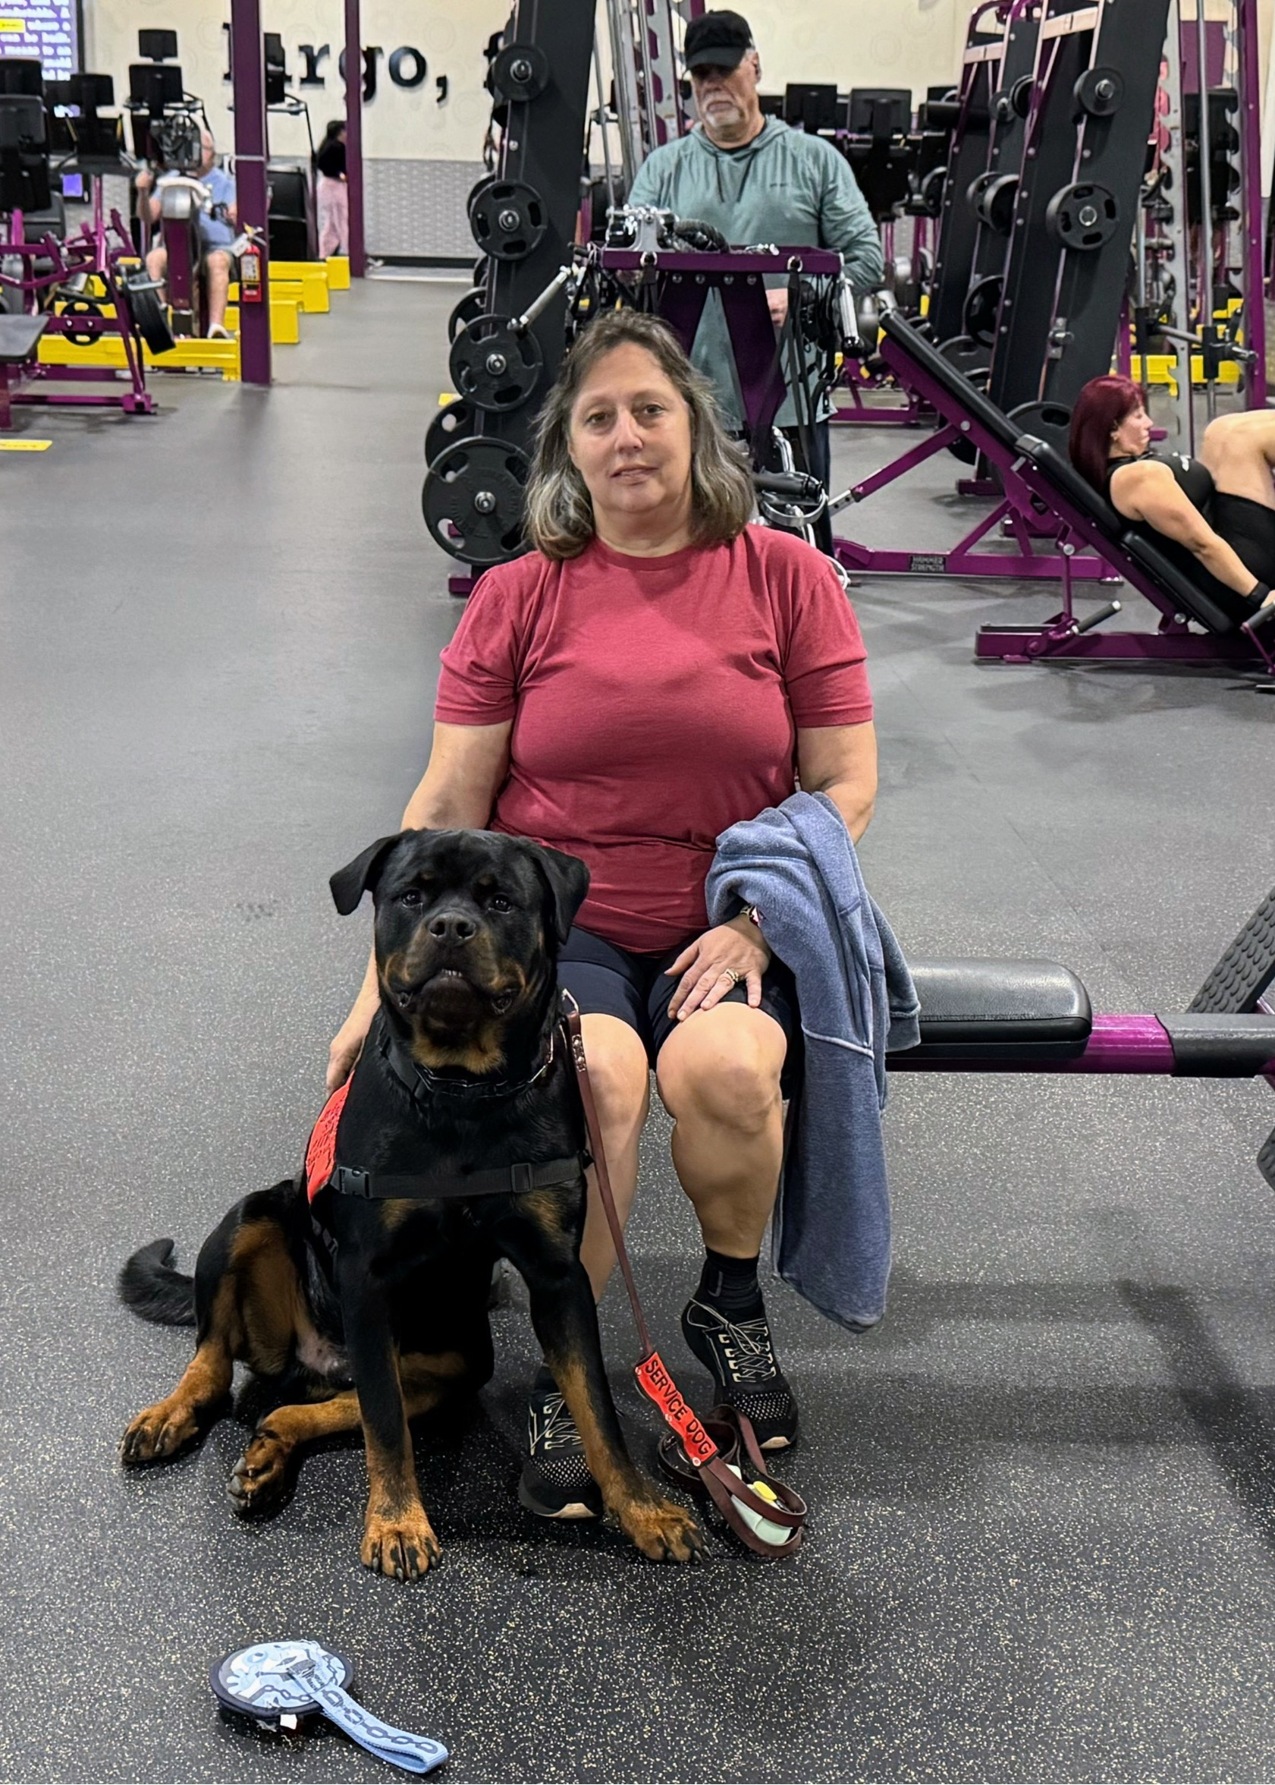
What Makes Me a Service Dog?
Trained to perform a task directly related to a person’s disability
I can be any breed or size of Dog (and yes there is something about small horses).
I don’t need to wear a vest, have a special ID, or go to a fancy school to do my job.

Slide 4
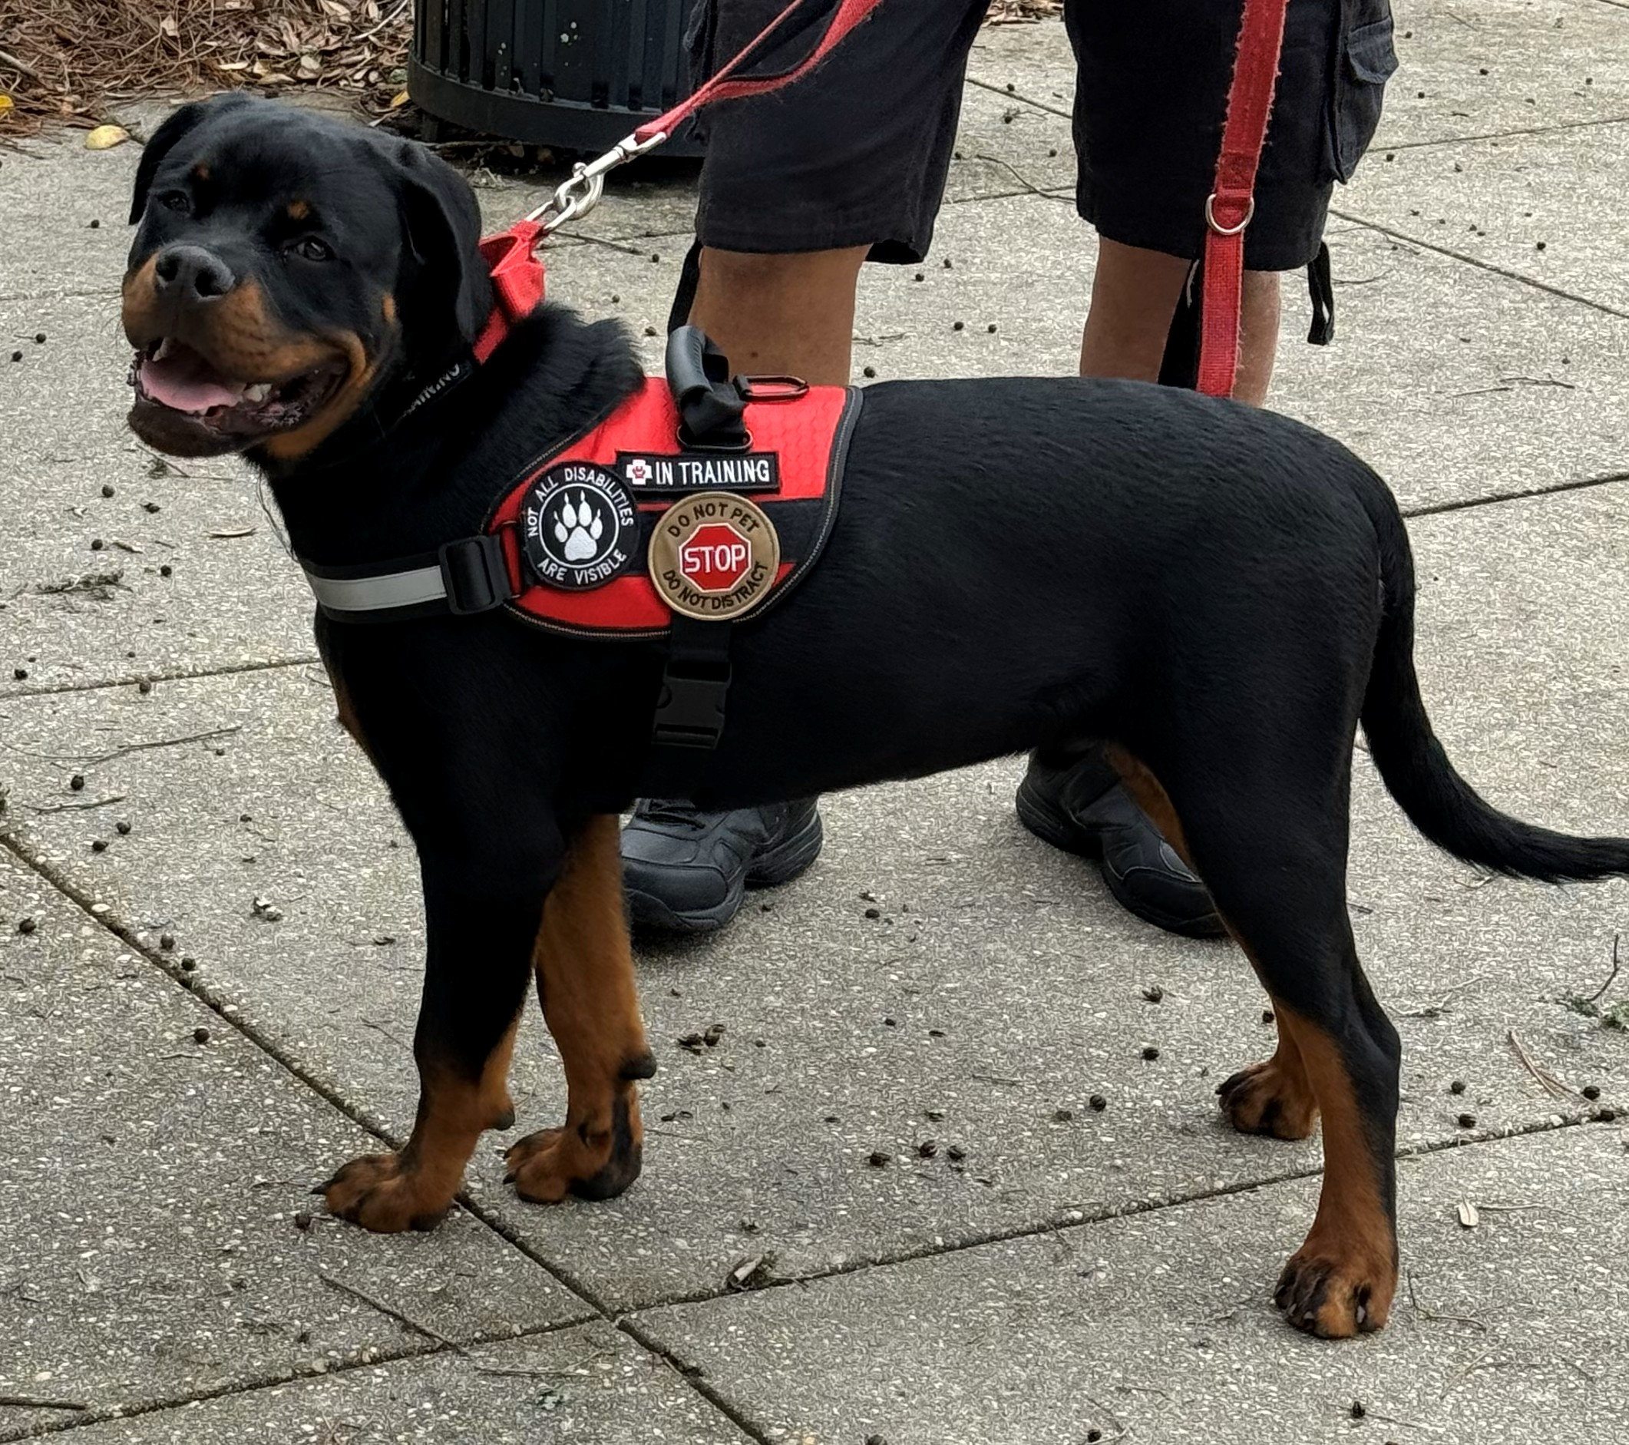
What I’m Not
I’m not a pet or an emotional support animal (ESA).
ESAs provide comfort, but they are not highly trained for specific tasks like me.
If a dog’s only job is to make someone feel better by being there, that’s not a service dog.

Slide 5
Some of My Jobs
I can do Deep Compression Therapy for my mom.
I can find my Mom or Dad if the other needs help.
I can sense a panic attack coming and help calm my mom down.
I can even detect her migraines and help keep mom safe!
I can also find my mom a safe place to sit down to rest.

Slide 6
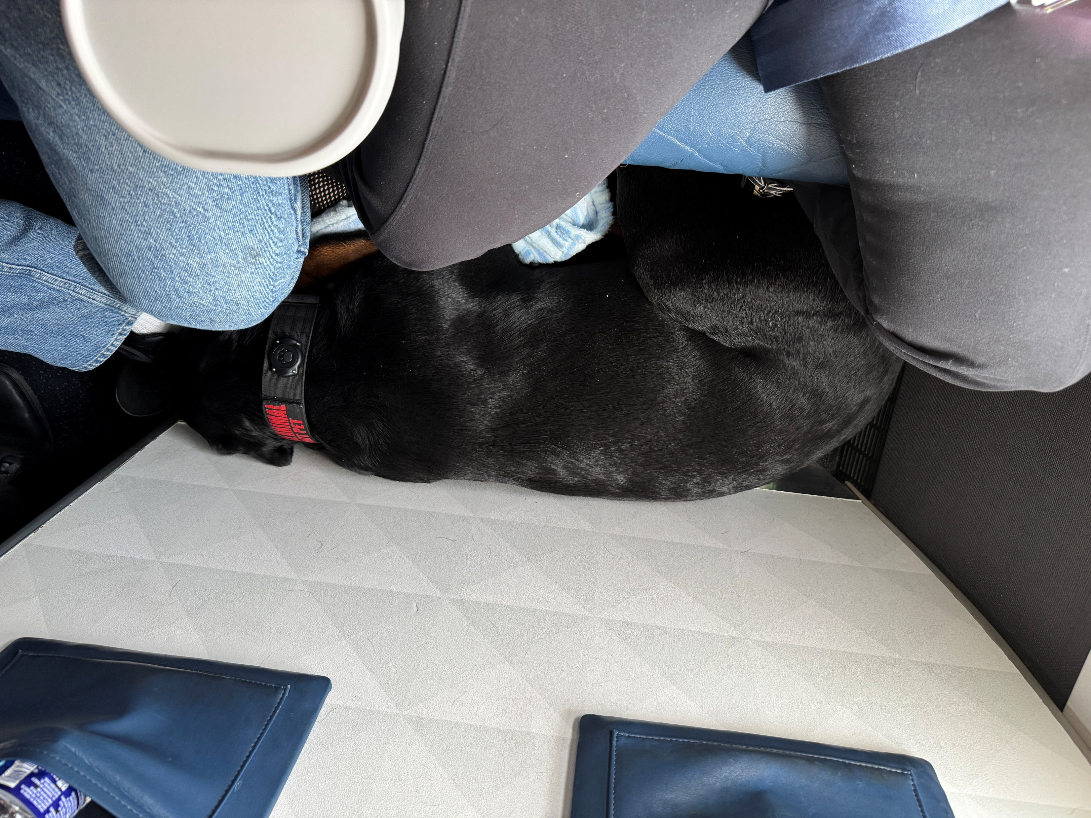
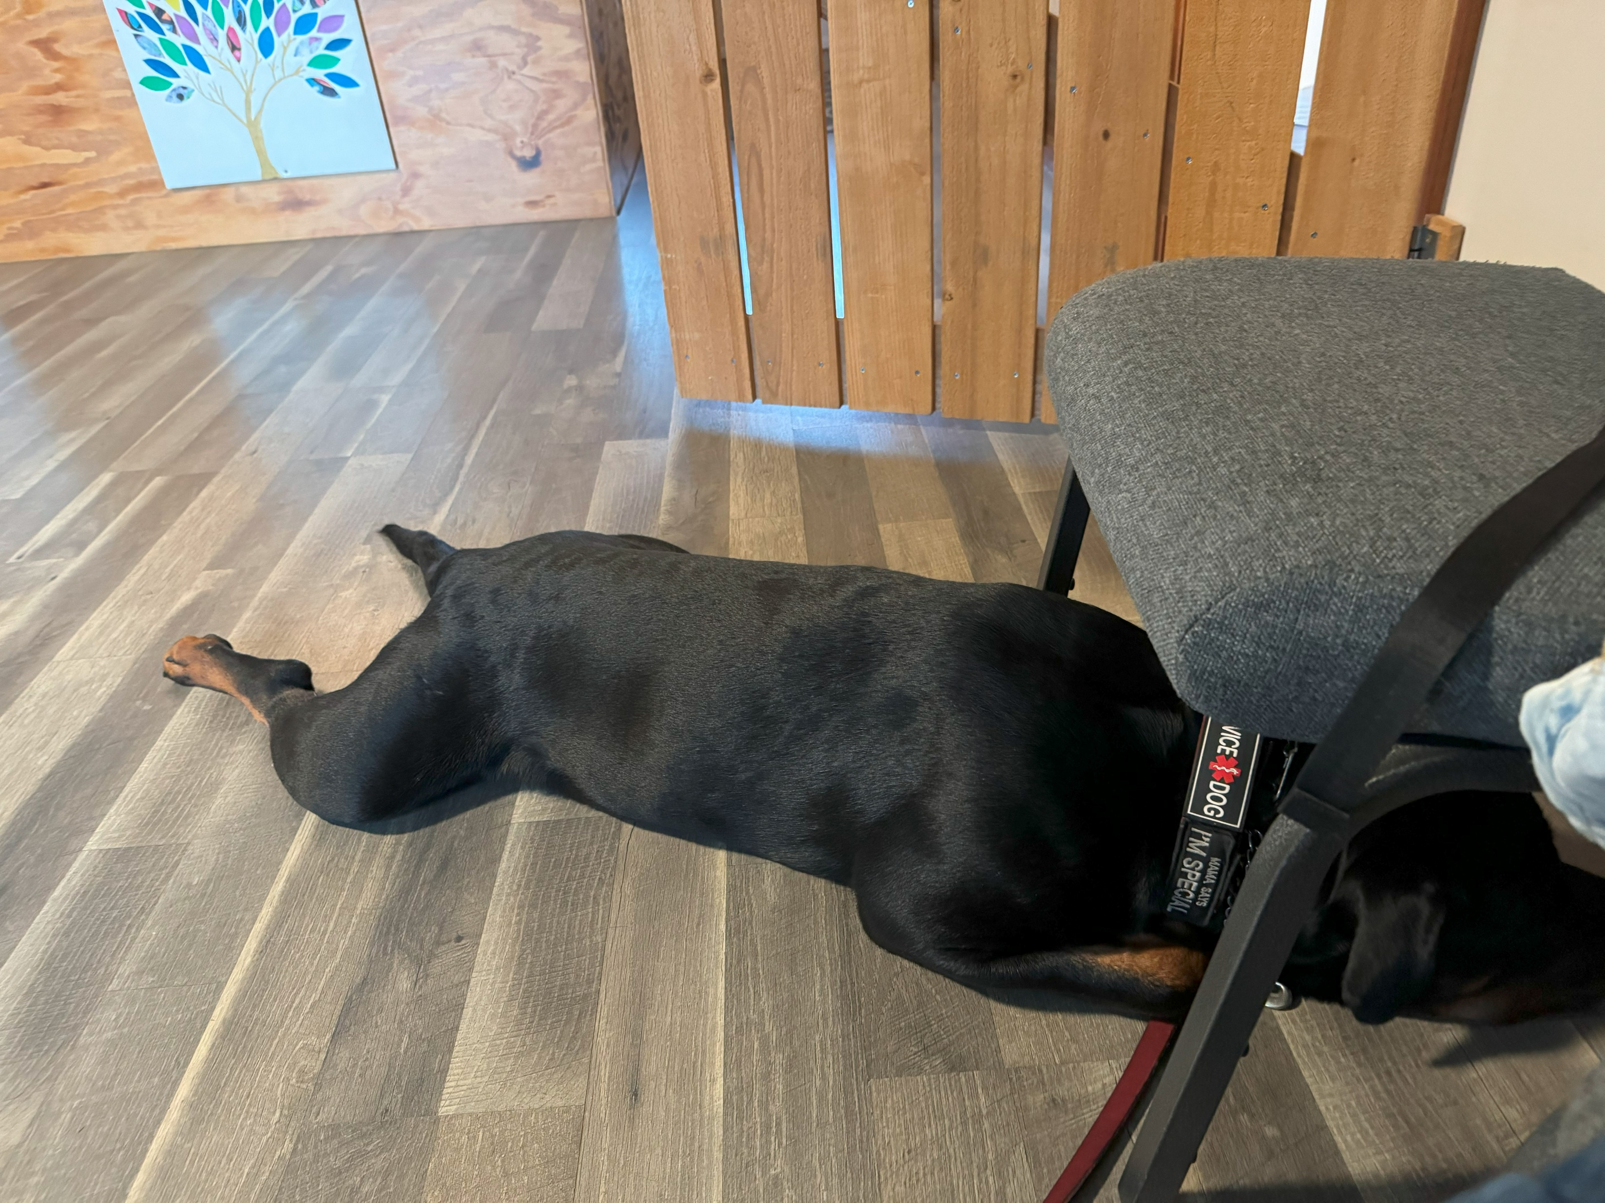
Where Can I Go?
I can go almost anywhere my person goes, even places where regular pets aren’t allowed, like:
  Restaurants
  Schools
  Hospitals
  Hotels
  Stores
  Aquariums
  Musame
  Mall
  Airplanes
  To keep this privilege, I need to be a very polite puppy and use my manners. I do my best to tuck but being a big guy, I don’t always fit.

Slide 7
Special Housing and Travel Rules
Housing: Some homes, like college dorms or public housing, must allow me to live with my person. Contact your Colleges Disability department.
Airplanes: The DOT(Department of Transportation) has a form that must be processed 2 week before flying. However; we have had several family emergencies where the airline disability department was able to fast forward this.
Jobs: My person is protected by rules at work, too, thanks to the EEOC (Equal Employment Opportunity Commission.)ASK JAN Government Website

Slide 8
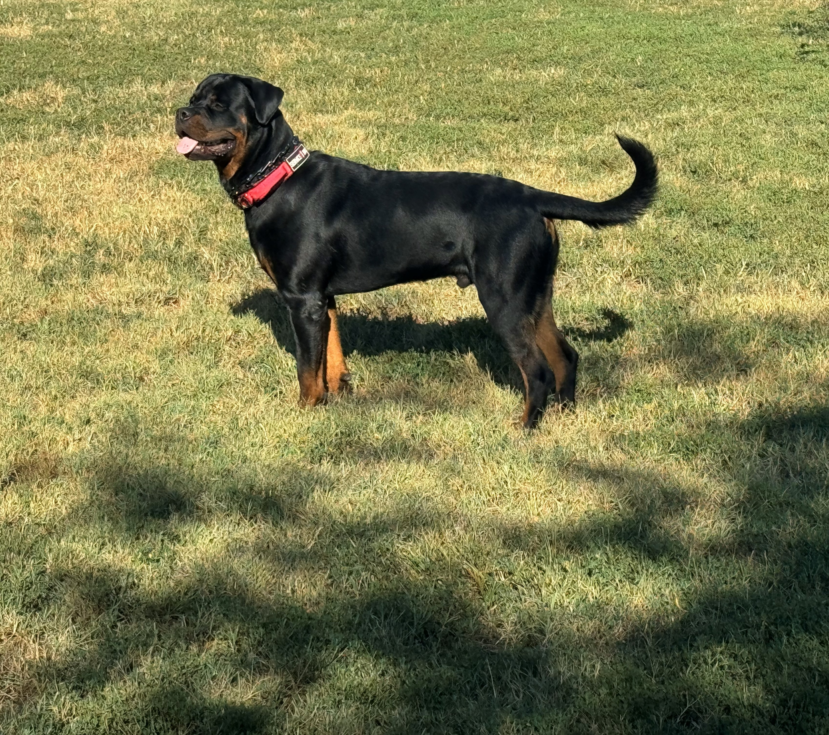
Questions People & Businesses
Can Ask About Me
If someone isn’t sure I’m a service dog, they can ask my person:
1. “Is this dog required because of a disability?”
2. “What job has the dog been trained to do?”
They can’t ask for proof, make me show my skills, or ask about my person’s disability.

Slide 9
When a Service Dog Might Not Be Allowed
Sometimes, Service dogs might not be able to stay if:
• They are not potty-trained.
• If they are out of control, and their handler can’t calm them down.

Slide 10
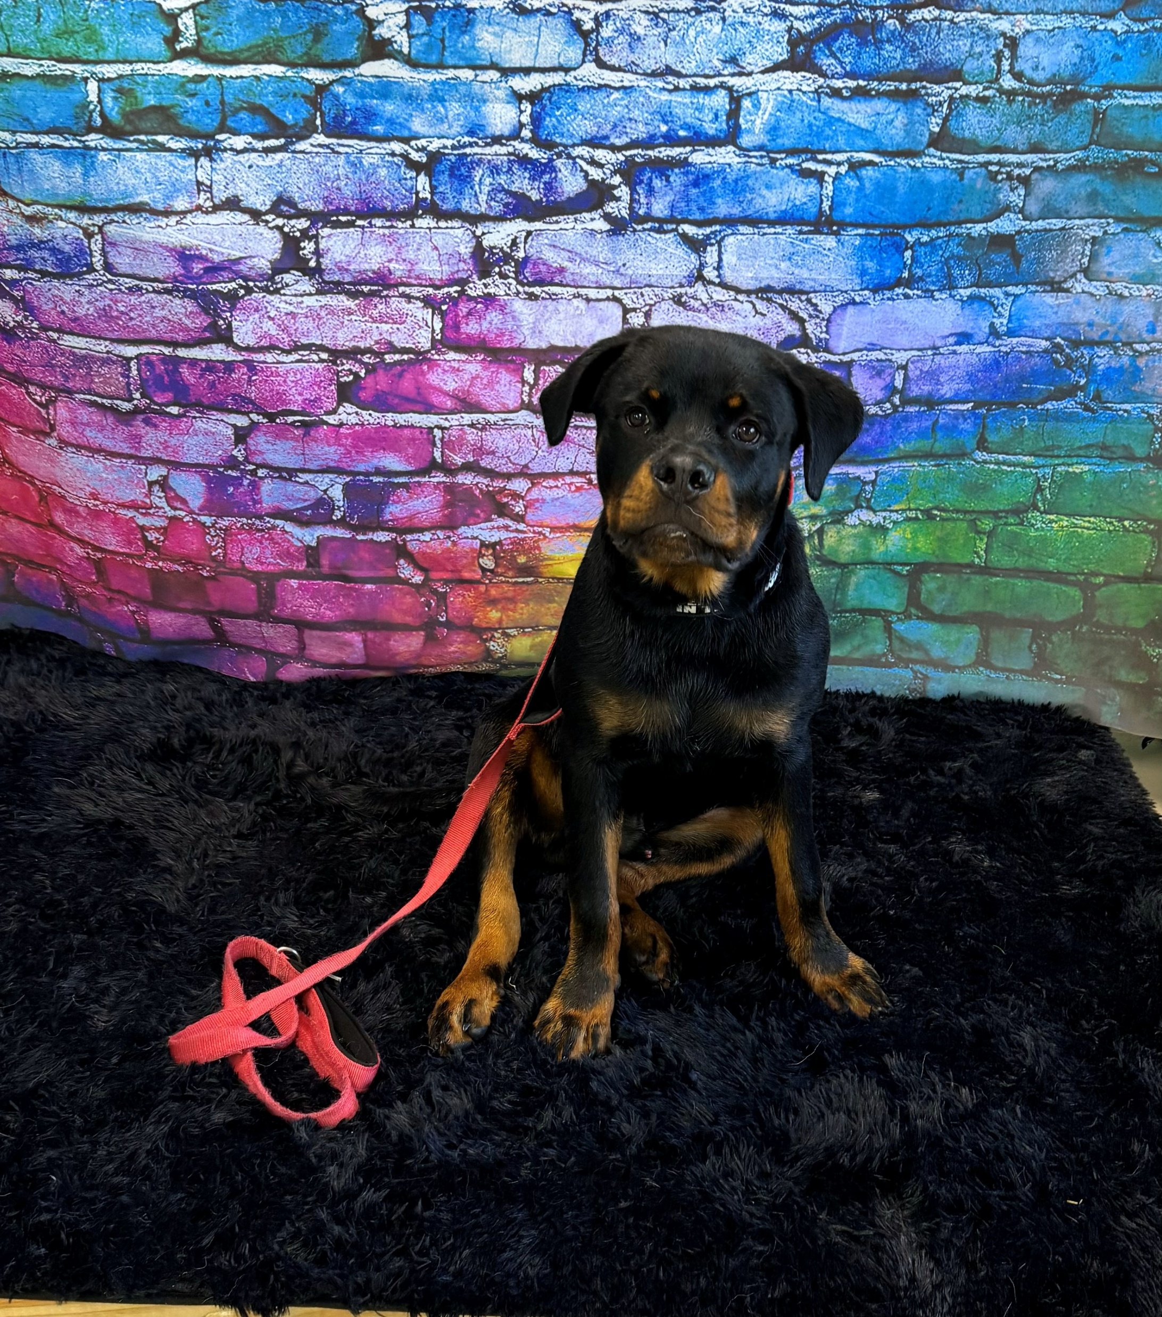
State and Local Rules
Local governments can make rules about licensing and vaccines for all dogs, including me.
But they can’t ban me because of my breed or force me to have a special service dog ID.
That’s it! I hope this helps you understand how important service animals like me are and the rules that keep us and our people safe and included.

